Slide 1
Using CIRCA for Special Collections: A Scalable Solution
Eli Brown, Acting Associate Director for Collections and Research Services
Gwynn Thayer, Acting Department Head, Special Collections
NC State University Libraries
Notes:
The purpose of our research forum presentation is not to focus on the technical components of Circa; rather, we aim to discuss its benefits for medium or smaller Special Collections in the spirit of collaboration.
Medium sized scrc in very large research library - this is why we developed this. We need to think of scale in terms of resources spent.

Slide 2
What is CIRCA?
Circa is a browser-based application for managing requests for materials in the NC State University Libraries’ Special Collections Research Center (SCRC).
Even though Circa was developed specifically for use by the SCRC, it was designed with sufficient flexibility to be useful to other libraries and archives with similar needs, especially those with smaller collections.
The application is open source and the code is available on Github.
Circa simplifies the SCRC internal workflows by:
providing a single system for creating requests
tracking movement of materials from storage locations to our Reading Room or other accession points
controlling and recording access to materials by researchers
providing extensive usage data to give insight into how and by whom our collections are used, which assists in planning and resource allocation

Slide 3
ArchivesSpace
Circa integrates with ArchivesSpace, the de facto standard, open source archival collections management system.
Container and location data stored in ArchivesSpace can be easily imported into Circa when items are requested and updated when the source data changes.
In addition to requests for on-site access to materials, Circa also aids in managing workflows for duplication requests from remote researchers, and for reproductions for publication.

Slide 4
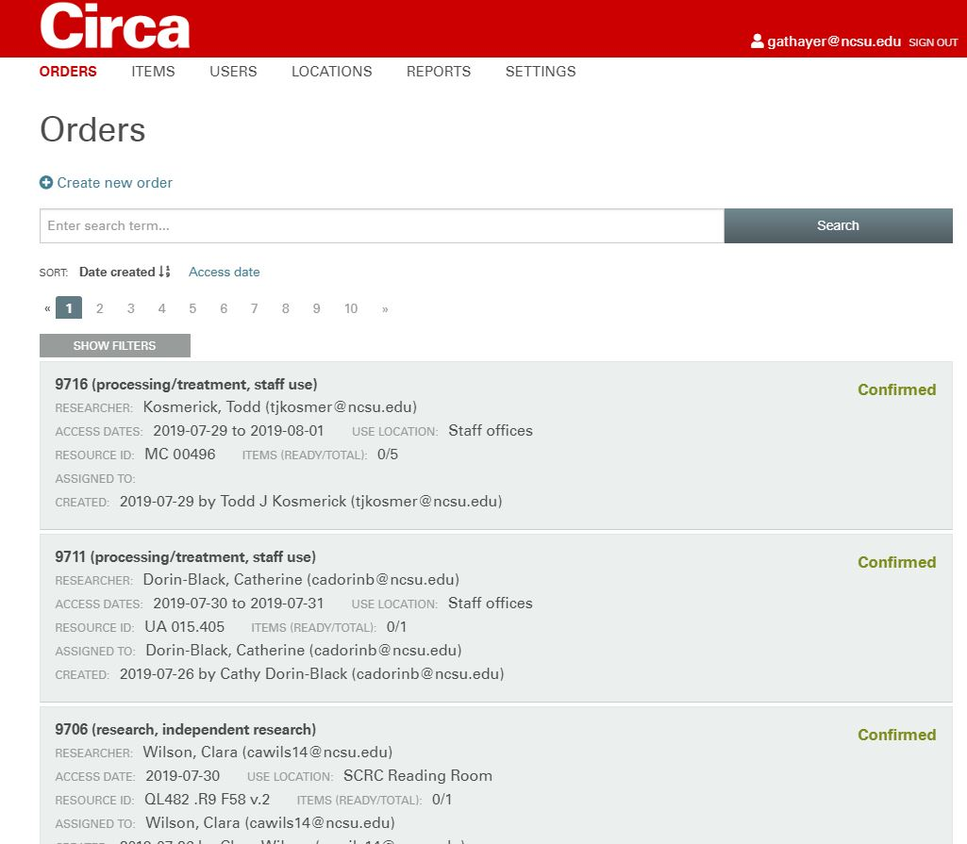

Slide 5
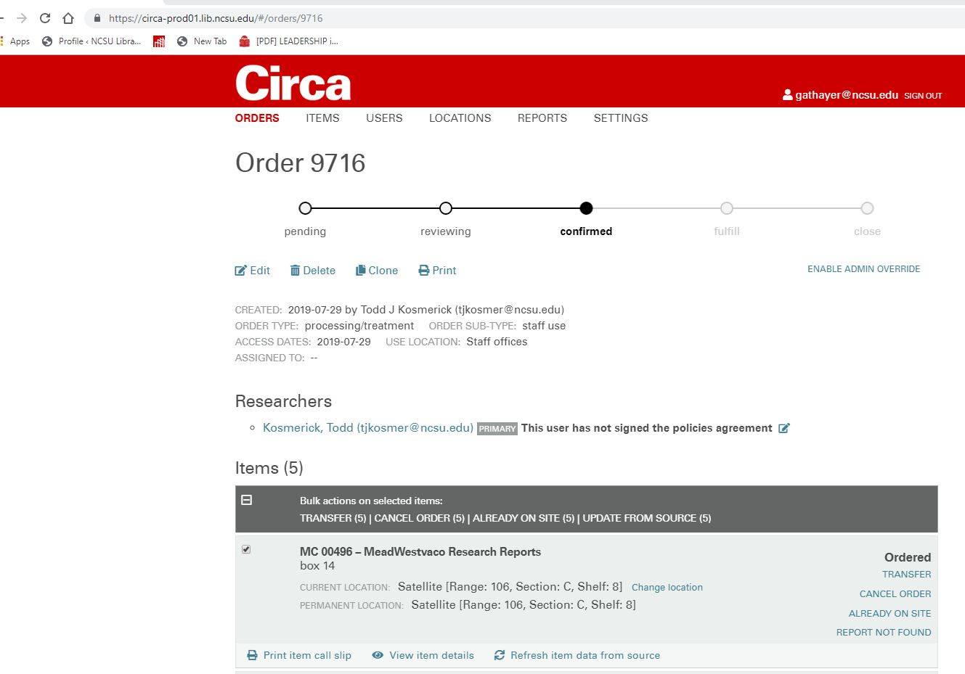

Slide 6
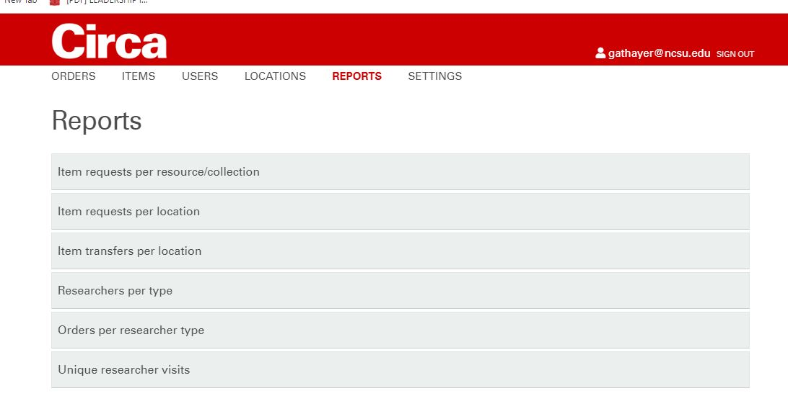

Slide 7
Circa infrastructure
Circa’s back end is a Ruby on Rails application that utilizes MySQL for data storage and Apache Solr for search.. The front end was built using the Angular.js framework.
To use Circa in production requires knowledge of deploying Rails applications on a web server or remote host.
System requirements:
Ruby 2.2.1 or higher
MySQL
Solr 5 or higher
Redis (to support email notifications)
Github repo: https://github.com/NCSU-Libraries/circa

Slide 8
Questions?
gathayer@ncsu.edu Gwynn Thayer
mbrown9@ncsu.edu Eli Brown
trthorn2@ncsu.edu Trevor Thornton (technical questions)

